Slide 1
Chapter 11 – Movement and Support

Slide 2
You should be able to
■ discuss the importance of locomotion in animals

Slide 3
Locomotion
The movement of an organism from place to place is known as locomotion.
Most animals show locomotion while plant movements are confined to cell and organ movement.
For animals, locomotion has the following uses:
to find food;
to escape from predators;
to look for mates;
to disperse offspring; and
to find new and favourable habitats.

Slide 4
11.1 The Skeleton of Man
You should be able to
■ relate the structure of the skeleton to its functions in humans;
■ identify and label the long bones of a fore and hind limb; and
■ distinguish between cervical, thoracic and lumbar vertebrae.

Slide 5
11.1 The Skeleton of Man
The functions of the skeleton are as follows:
Support – rigid framework that maintains the shape of the body; supports the organs suspended within it.
Protection – soft and delicate tissues and organs are protected by the skeleton.
Movement – muscles can attach to the bones.
Production of blood cells – red and white blood cells are made in the bone marrow.
Storage of minerals – calcium and phosphorus levels are maintained by storing the excess in the bones.

Slide 6
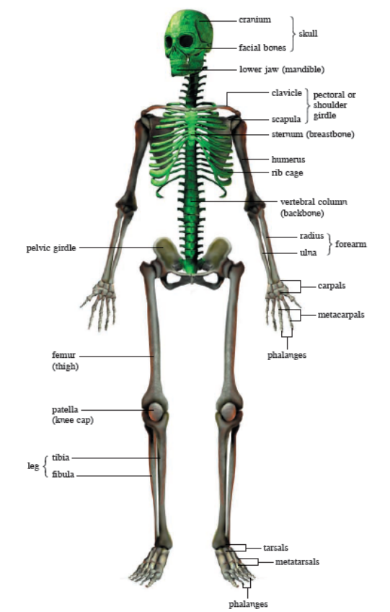
11.1 The Skeleton of Man
Structure of the Human Skeleton
The skeleton can be divided into two main parts – the axial skeleton and the appendicular skeleton

Slide 7
11.1 The Skeleton of Man
The axial skeleton consists of:
Skull (cranium and facial bones)
  The cranium has a number of flat bones fitted together at immovable joints.
Vertebral column
  The backbone has 33 bones called vertebrae placed end to end, each separated from the other by a cartilage disc.
Ribcage and sternum

Slide 8
11.1 The Skeleton of Man
The appendicular skeleton is made up of:
Arms and legs
  The upper part of the limbs consists of single long bones – the humerus in the arm, and the femur in the leg.
  The lower part of the limbs has a pair of bones below the elbow or knee – the radius and ulna in the arms, and the tibia and fibula in the legs.
Pectoral and pelvic girdles
  The pectoral, or shoulder, girdle, consists of the clavicle (collar bone) and scapula (shoulder blade). This girdle connects the humerus to the rest of the skeleton.
  The pelvic girdle consists of two halves. These two hip bones form a hollow cavity known as the pelvis.

Slide 9
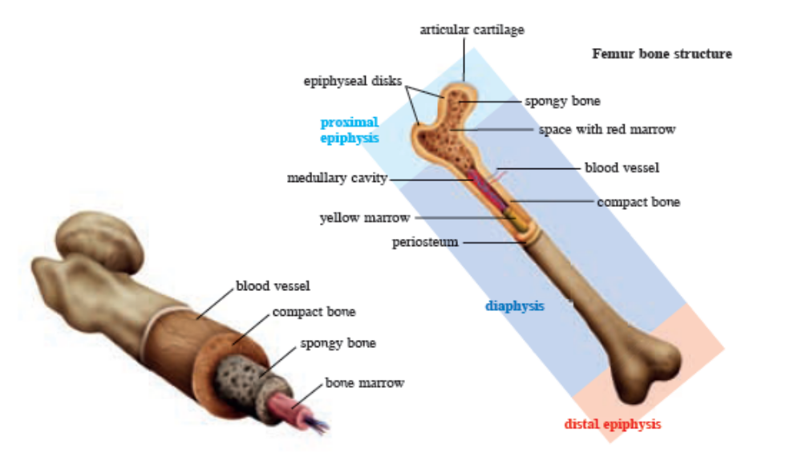
11.1 The Skeleton of Man
Structure of the Bones
A bone is a type of connective tissue with cells embedded in a web of minerals and collagen fibres.

Slide 10
11.1 The Skeleton of Man
Structure of the Bones
The central cavity of the diaphysis contains yellow bone marrow, which is mostly stored fat.
Red bone marrow, found in the spongy bone, manufactures the blood cells. The bone has a network of blood vessels running across it to supply nutrients to its cells.

Slide 11
11.1 The Skeleton of Man
Limb bones are important for movement and support. The structure of the limb bone is adapted for its function in the following ways:
  compact bone to support weight of body or objects held by limb
  long to increase reach or stride
  surfaces for articulation e.g. ball and socket allowing a wide range of motion within a socket

Slide 12
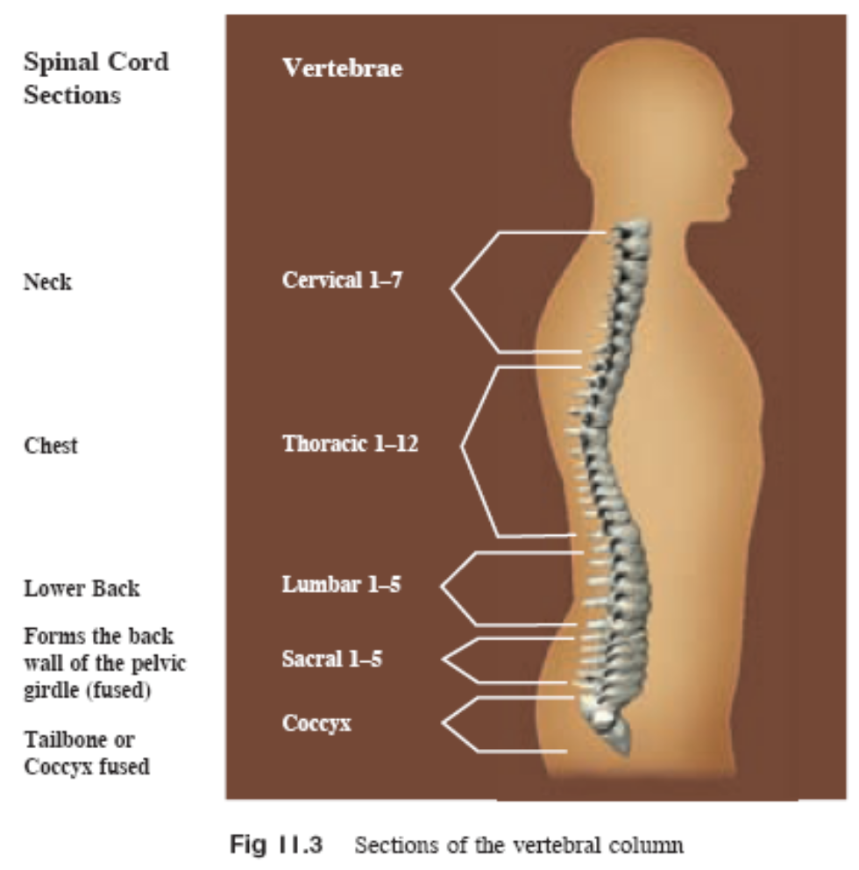
11.1 The Skeleton of Man
The Vertebral Column
All the vertebrae share the
same basic structure. When
stacked on top of each
other, they form a hollow
tube in the centre, through
which the spinal cord
passes.

Slide 13
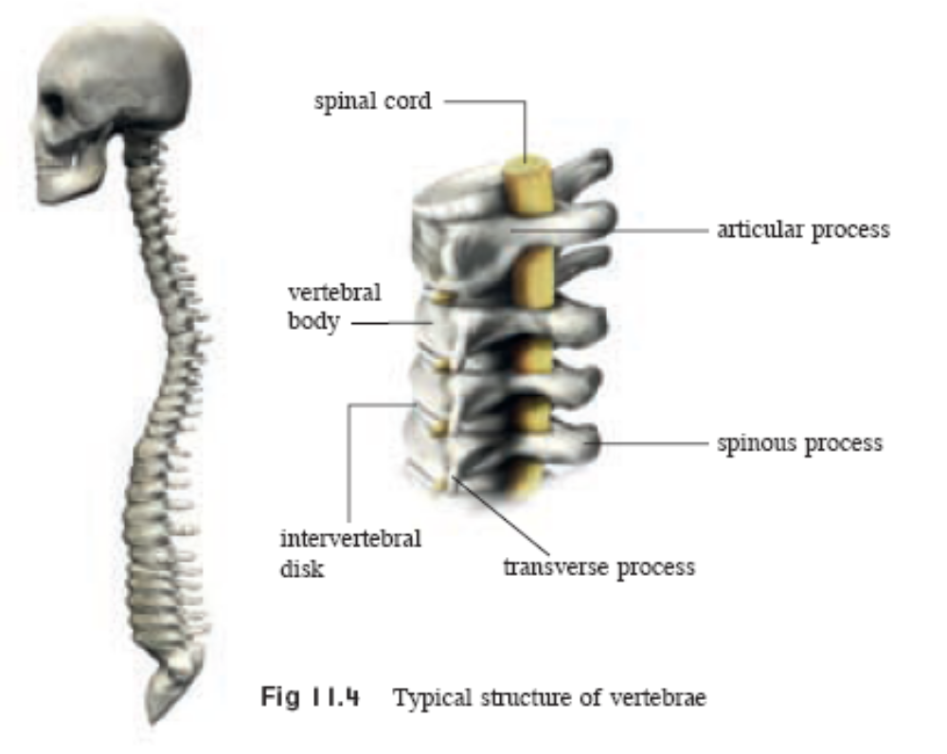
11.1 The Skeleton of Man

Slide 14
11.1 The Skeleton of Man
The vertebrae consist of the following common
elements:
Vertebral body or centrum – largest part of a vertebra that supports the weight of the body and trunk.
Neutral canal – opening for the protection of the spinal cord.
Processes – articular, transverse and spinous; they serve as connection points for ligaments and tendons.
Articular – forms facet joints with that of adjacent
vertebrae; facet joints enable spine to bend,
twist and extend in different directions.
Transverse – sites of attachment for spinal muscles.
Spinous/neural spines – posterior to vertebral body

Slide 15
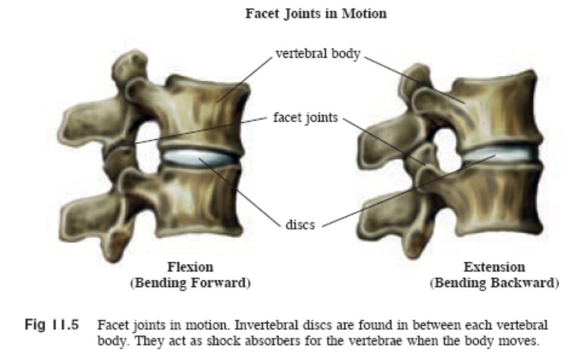

Slide 16
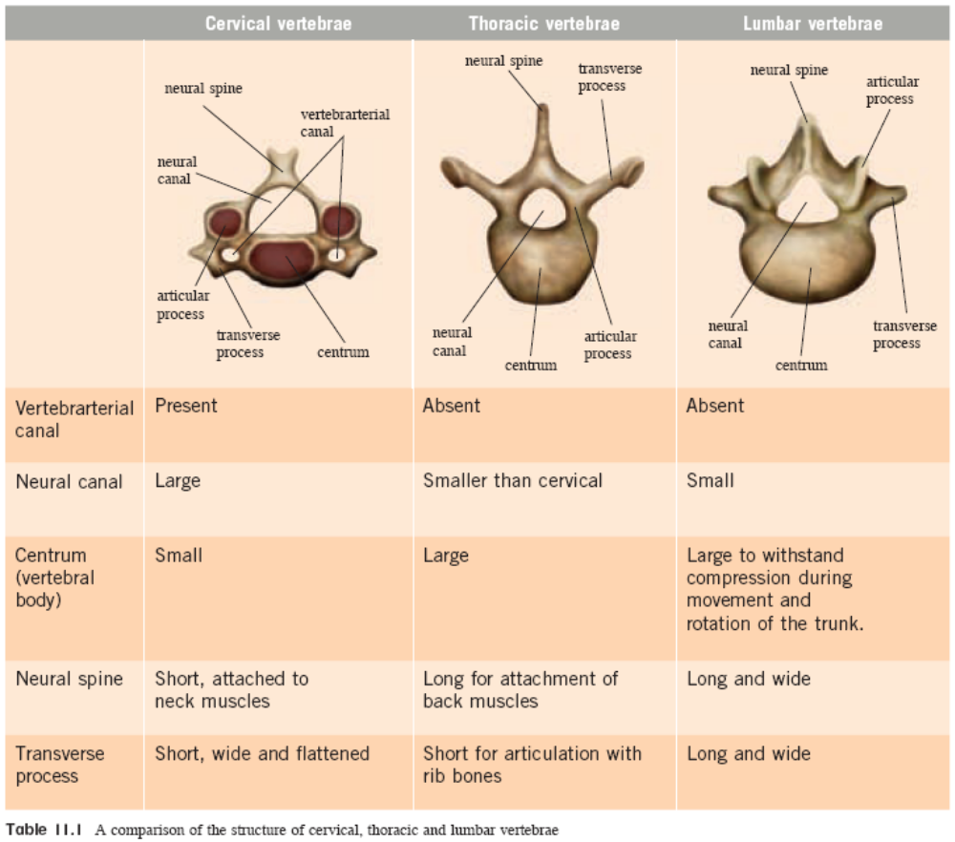
11.1 The Skeleton of Man

Slide 17
11.2 How We Move
You should be able to:
■ describe the mechanism of movement in a human limb;
■ describe the behavior of antagonistic muscles; and
■ describe the types of joints.

Slide 18
11.2 How We Move
Movement is brought about by the coordination of nerves, muscles, tendons, bones and ligaments.
Muscles are made up of muscle fibres. In a passive state, the muscles are relaxed. When stimulated by nerves, they contract and shorten to bring about movement of the bones.
Both ends of a muscle are joined to the bone by the tendons which are inelastic. They transfer all the force of the muscle contraction to the bone in order to move it.
Bones are connected to one another by ligaments, which are elastic, fibrous connective tissues allowing limited movement between bones and a joint.

Slide 19
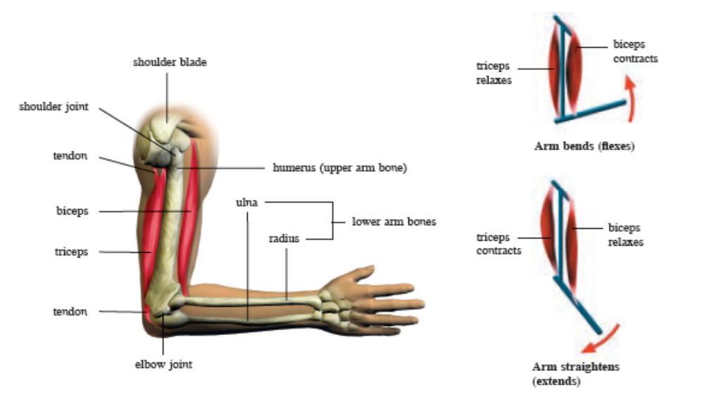
11.2 How We Move
The movement of the arm is carried out by the biceps and triceps muscles.

Slide 20
11.2 How We Move
Skeletal muscles usually work in pairs.
E.g. The biceps and triceps muscles
Contraction of the biceps (and simultaneous relaxation of the triceps) causes the arm to bend, so the biceps is known as a flexor muscle.
When the triceps contracts (and biceps relax), the arm straightens. The triceps is called an extensor muscle.
As they bring about opposite effects, the biceps and triceps are examples of antagonistic muscles.

Slide 21
11.2 How We Move
Joints can be classified as fibrous, cartilaginous, or synovial.
A fibrous joint is immovable and does not have synovial fluid or synovial membranes. Bones are connected by fibrous connective tissue.
E.g. is the sutures between skull bones.
A cartilaginous joint is one in which the bones are connected by cartilage. Slight movement is permitted.
E.g. the joints between the sternum and the rib bones, and also the vertebrae.
A synovial joint allows free movement. A fibrous capsule surrounds the bones, and encloses a cavity filled with synovial fluid and lined with synovial membranes.

Slide 22
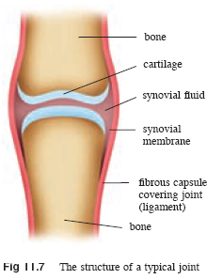
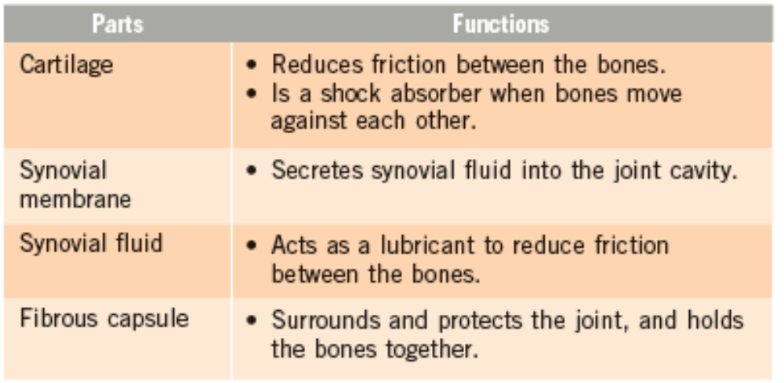
11.2 How We Move
Parts of a Synovial Joint

Slide 23
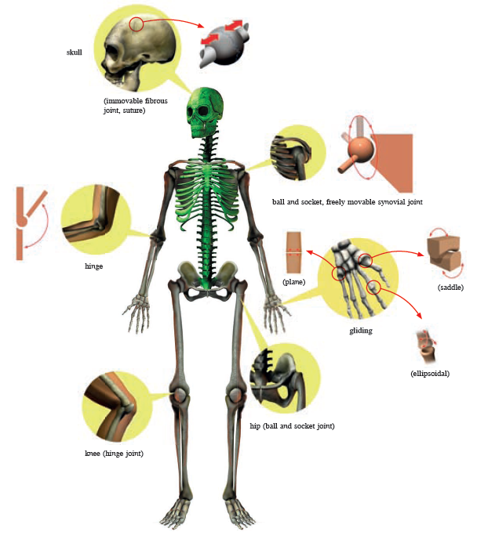
11.2 How We Move
Types of joints in the body

Slide 24
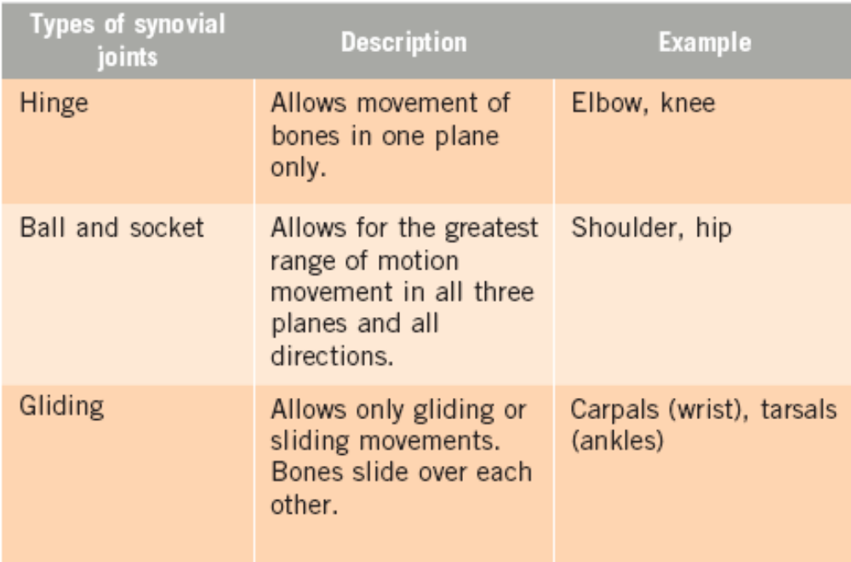
11.2 How We Move
Synovial joints are the most common and movable type of joint in the body.

Slide 25
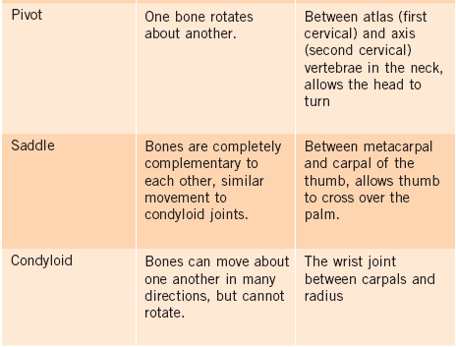
11.2 How We Move

Slide 26
11.2 How We Move
Levers and Joints
Most joints use the principle of levers to enable movement.
Levers are simple machines which can amplify force or movement.
A lever system is made up of a rigid rod that pivots around a stationary point known as the fulcrum.
In human body systems, the bones (usually long bones) act as the lever arms, the joints as the fulcrum, and the muscles provide the effort to move loads.
Loads are usually the weight of the body parts that are moved or the force required to lift or push objects outside the body.

Slide 27
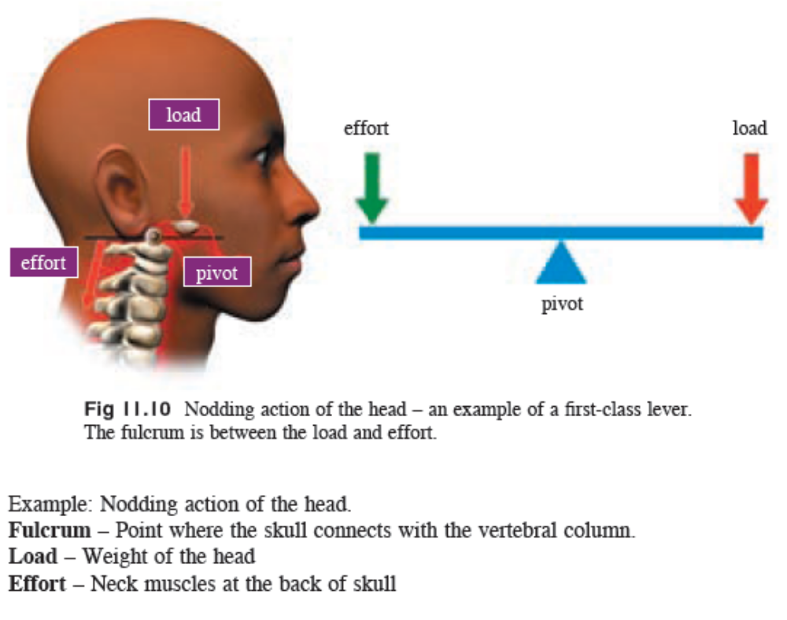
11.2 How We Move
First-class Lever

Slide 28
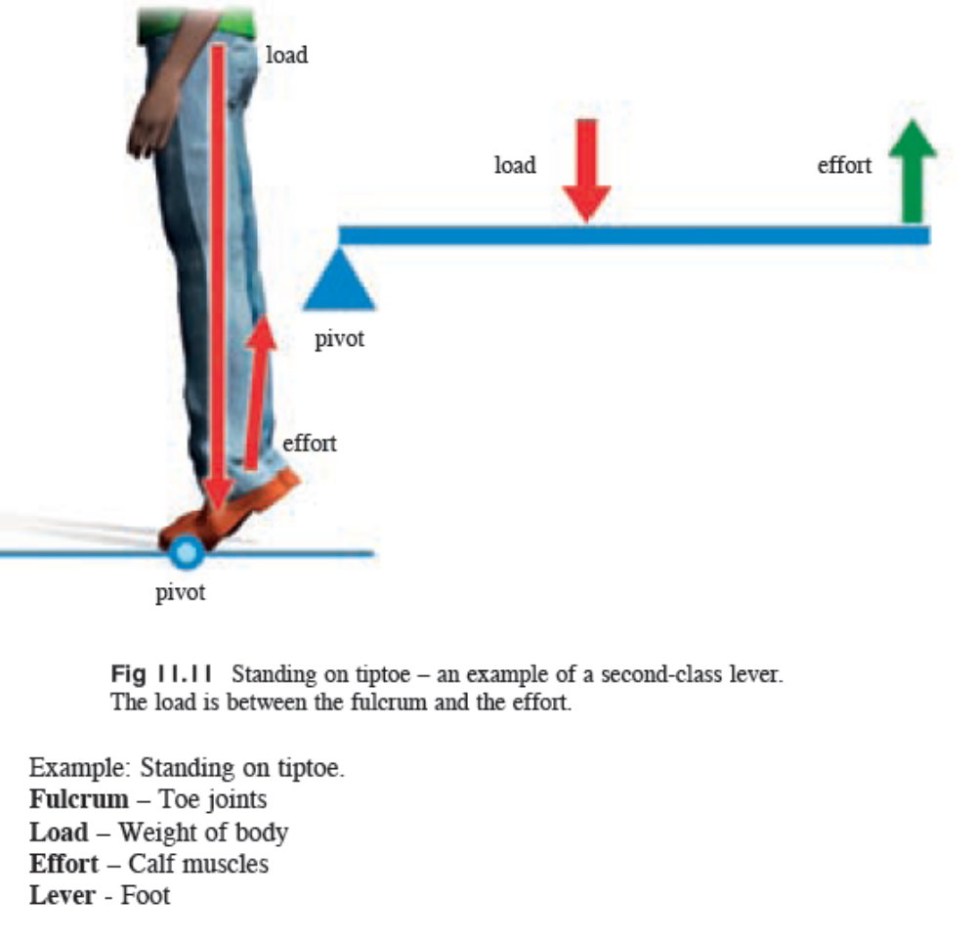
11.2 How We Move
Second-class Lever

Slide 29
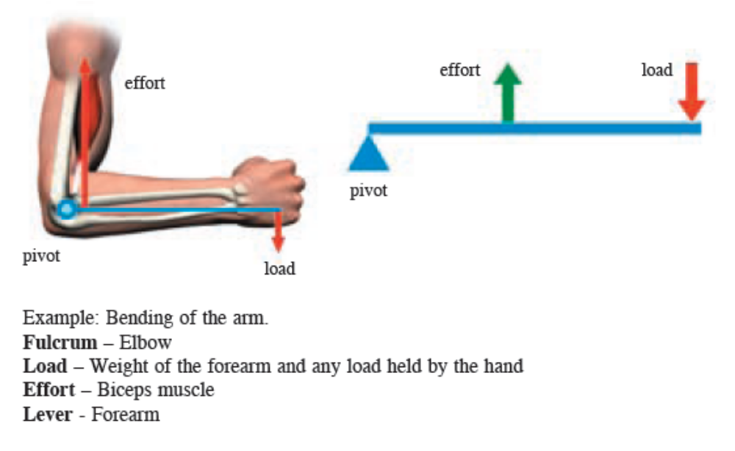
11.2 How We Move
Third-class Lever

Slide 30
Key Concepts
The skeleton is made up of the axial skeleton consisting of the cranium, vertebral column and ribcage, and the appendicular skeleton comprising the limbs and girdles.
A bone is a type of connective tissue. It forms a hollow shaft of compact bone filled with yellow bone marrow, with red bone marrow found near the ends.
The vertebral column is divided into the following regions: cervical, thoracic, lumbar and sacral vertebrae.
Bones are connected by ligaments, while tendons join bone and muscle.
Movement of a limb takes place at the joints, usually by the coordinated effort of antagonistic muscles.

Slide 31
Key Concepts
Joints can be classified as fibrous, cartilaginous or synovial. Compared to the other two, synovial joints allow for free movement.
Joints use the principle of levers to enable movement. The bones act as the lever arms, the joints as the fulcrum, and muscles provide the effort to move loads.
The two main types of movable joints are the hinge joint allowing movement in one plane, and the ball and socket joint allowing movement in all planes.

